Slide 1
https://FullStackUX.dev
Design & research fundamentals
For Developers!
Please arrange yourselves in groups of three and open the following link:

Slide 2
Design & research fundamentals
Alex white
For Developers!

Slide 3
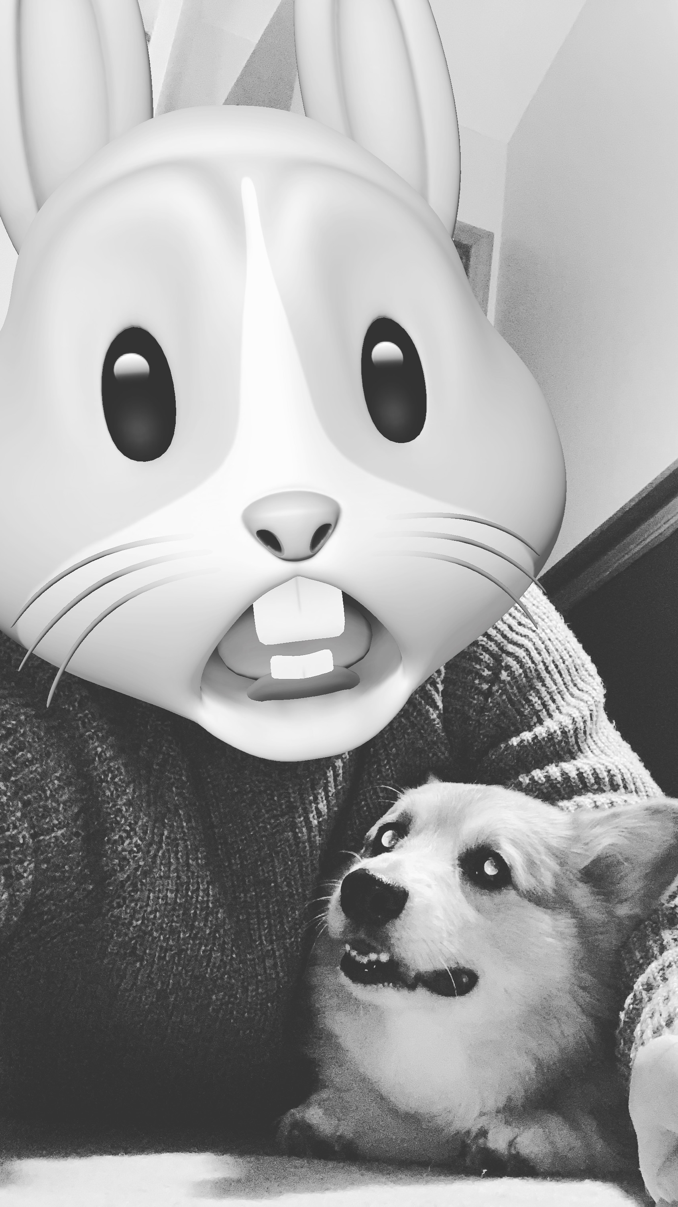
Hi, I’m Alex!
Senior UX Developer & Consultant @ Insight Digital Innovation
Pupper dad
“Full Stack UX” advocate

Slide 4
Why full stack UX?
Introduction
Speak a common language with designers and researchers
Help better guide the direction of a project
Fill in gaps when UX specialists are not available
Become a more effective developer
Notes:
Full stack focuses on backend and uses bootstrap, full stack UX focuses on development but can use UX
Help know when to suggest bringing in dedicated UX resources
Able to fill in small gaps when a button design is missing or a screen wasn’t mocked out

Slide 5
What does full stack UX look like in practice?
Notes:
I work in UX and thus have a lot of UX designers and researchers that have been able to teach me their side of things
So I’ve been able to bring this to my client work

Slide 6
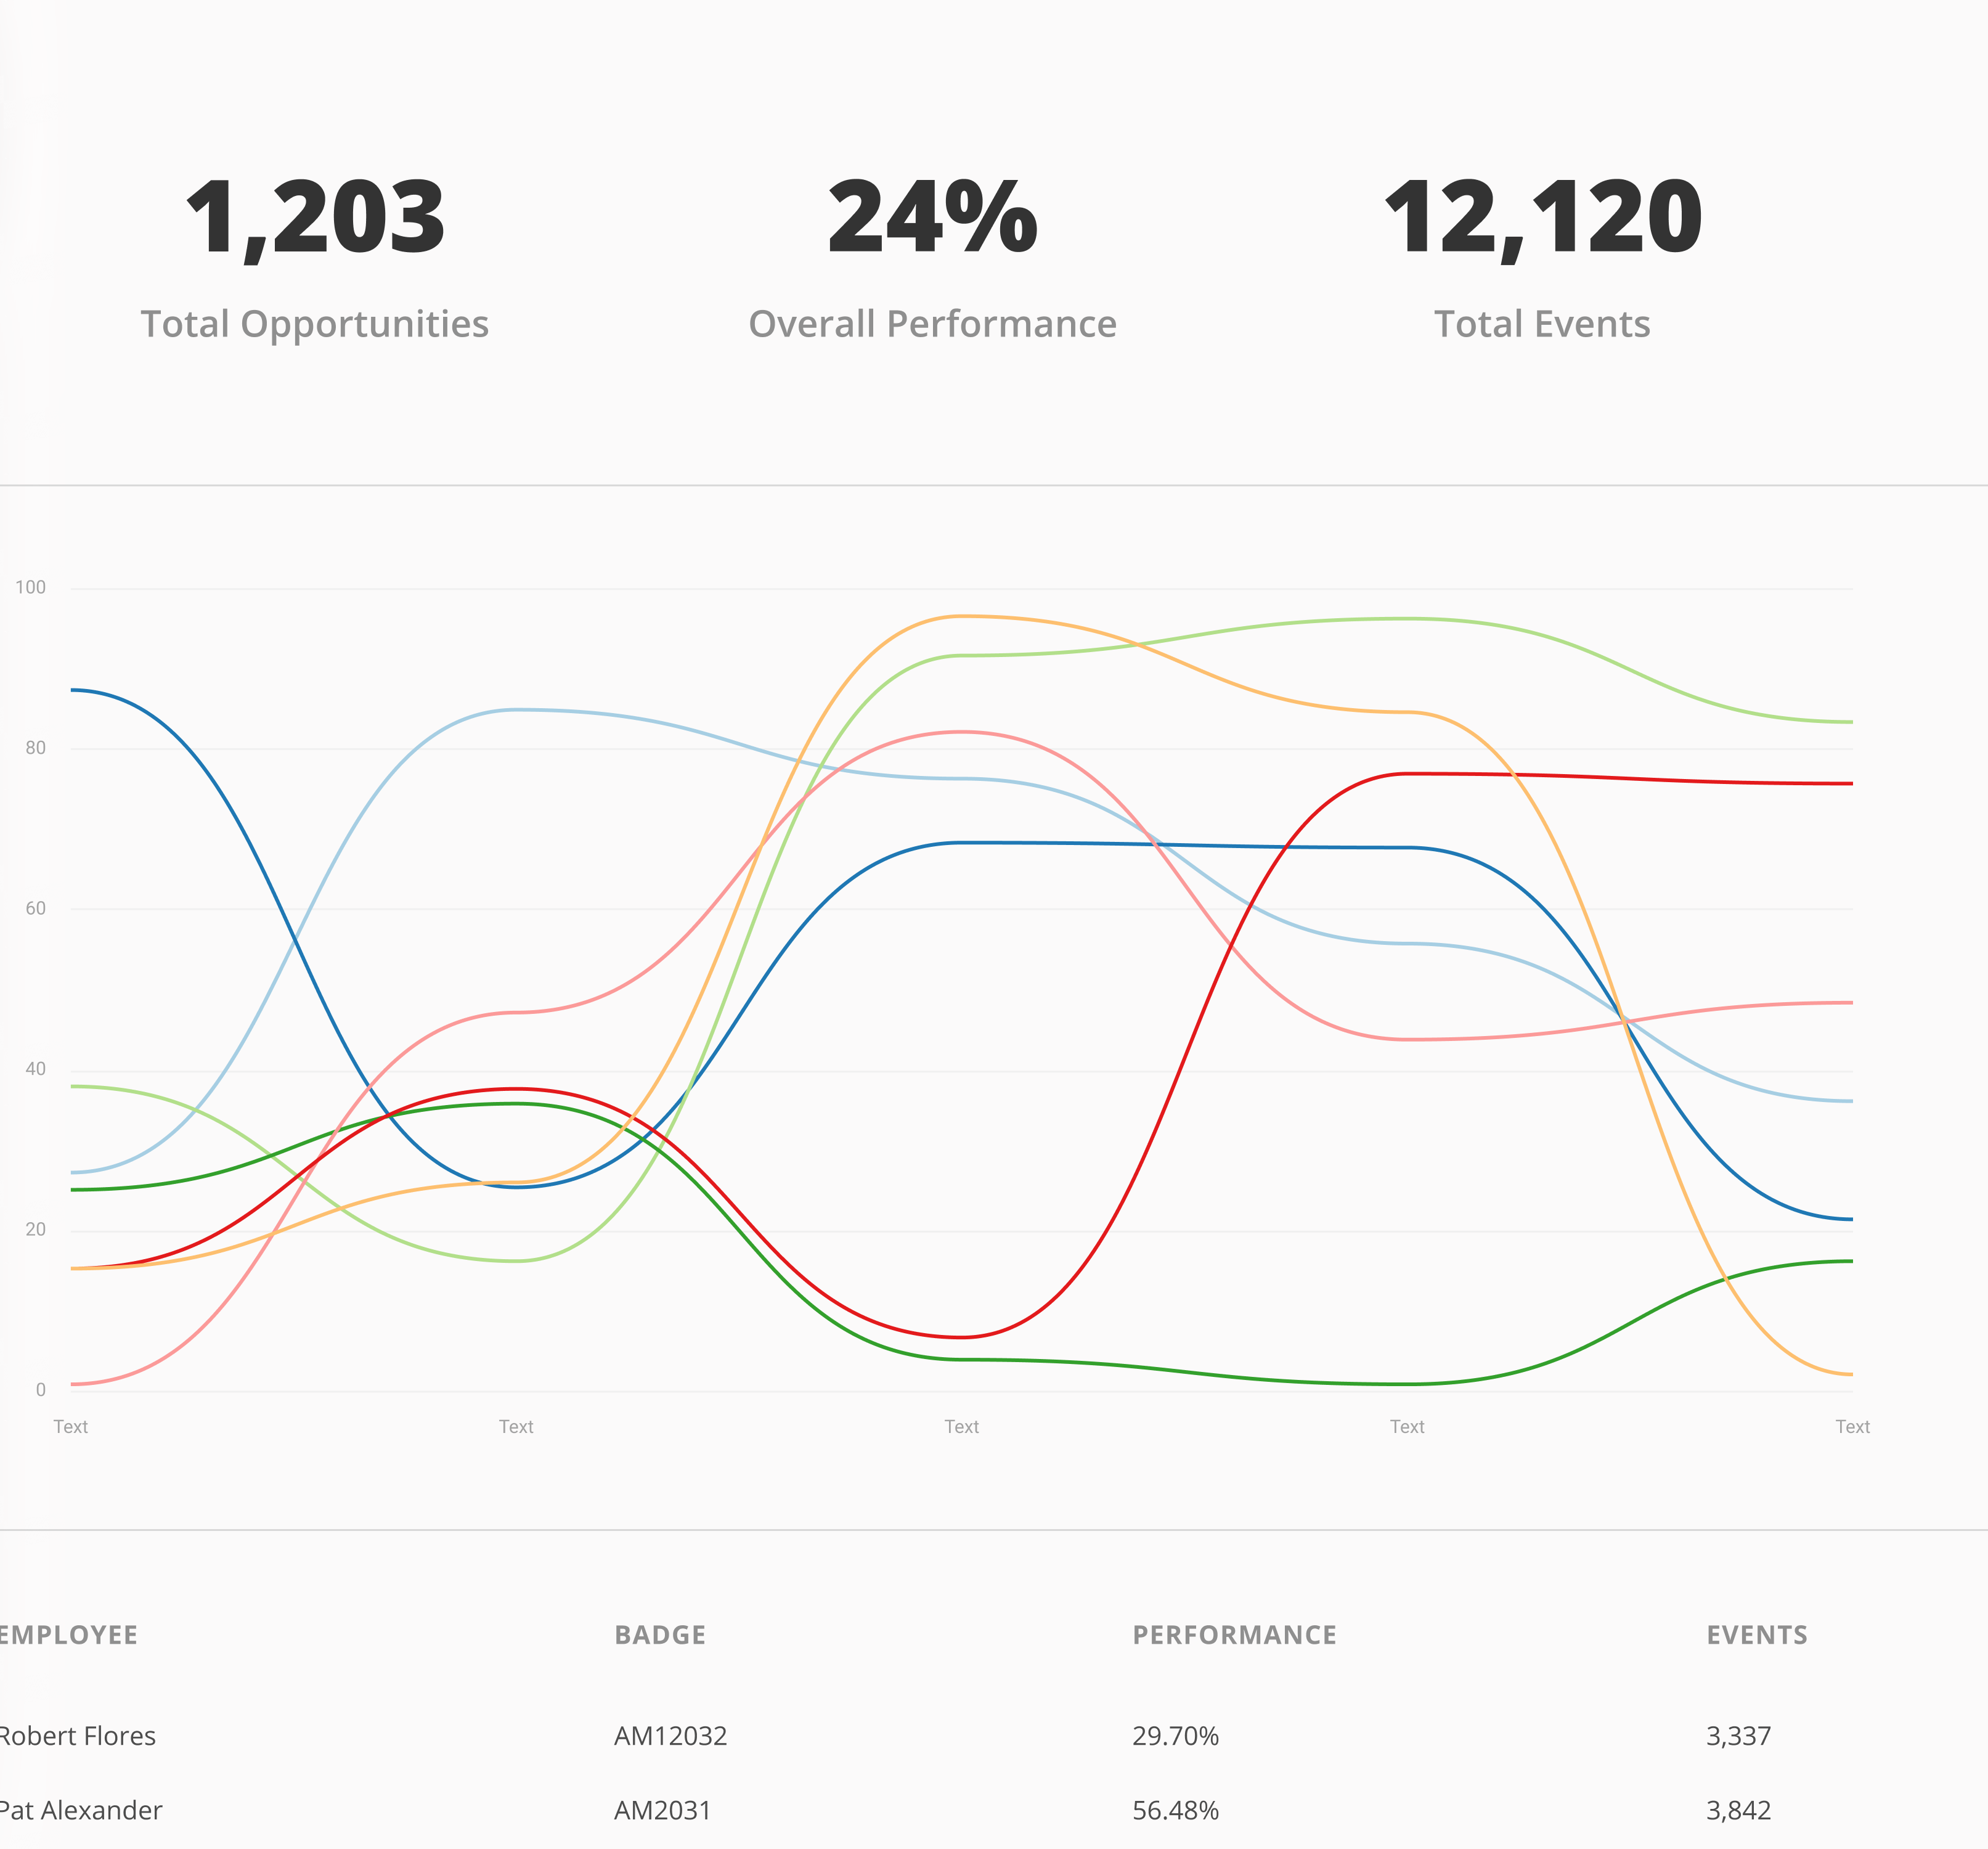
Client redesign
Full stack UX in practice
I was able to use my relationship with the client as a developer to suggest devoting time to UX
I led a UX research initiative with interviews and usability studies with employees and customers
I was able to successfully gauge what was possible and estimate timeframes when presenting designs
Notes:
We had been shooting in the dark when building new features
Client had never brought on a researcher
Conducted interviews to gather requirements on what customers needed to better perform their jobs
Used requirements to create design and prototype. Led usability studies to validate designs, went through multiple iterations
Customers get something that truly helps them better perform their day to day, and they feel like their voice is being heard since they are part of the process.

Slide 7
today you will all become full stack UX developers!

Slide 8
Workshop goals
Be able to use design software to develop interactive prototypes
Understand the different types of UX research and feel comfortable running a usability study
Learn how to summarize findings and present to stakeholders
Notes:
Present to stakeholders (time allowing)

Slide 9
agenda
Add a feature to an existing prototype as a class
Split into groups and conduct a usability study
Analyze study results and draft requirements for changes within groups
Redesign feature within groups
Conduct a second usability study
Create and present a findings report (time allowing)
Notes:
So let’s introduce this prototype you’ll be adding a feature to!

Slide 10
CodeMash scheduling app
Notes:
At this point, switch over to Figma to show the scheduling app prototype

Slide 11

Rideshare for
CodeMash
New feature
Notes:
“Conference” has said they want to add a feature that really draws people into the app
Shuttle doesn’t hit all the hotels, and Lyft/Uber is limited, so let’s add a CodeMash specific Rideshare feature!
Our first step is to figure out what the typical conference attendees would like to see from this feature, so let’s meet paul

Slide 12
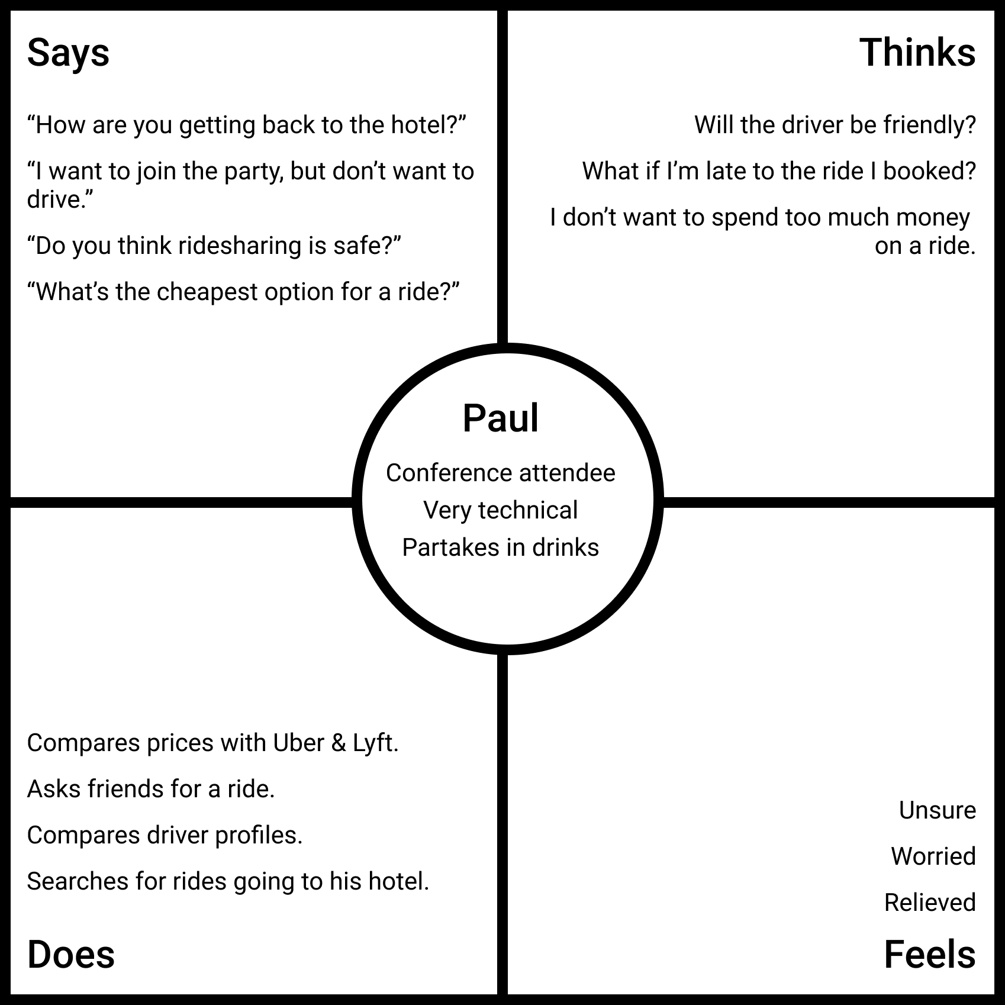
Meet our user
Rideshare for CodeMash
Notes:
Paul is an average conference attendee. He’s very technical, and he likes to partake in drinks.
This is Paul’s empathy map. And empathy map lists out the things Paul says, thinks, feels and does in regards to our Rideshare feature.
The things that Paul says around coworkers, friends and fellow conference attendees are:
“How are you getting back to the hotel”
“I want to join the party, but don’t want to drive”
“Do you think ride sharing is safe”
“Whats the cheapest option for a ride”
The thoughts going through Paul’s mind are:
“Will the driver be friendly”
“What if I’m late to the ride I booked”
“I don’t want to spend too much money on a ride”
Paul’s feeling while using the feature are:
“Unsure”
“worried”
“Relieved”
The things Paul does while using the feature are:
“Compares prices with Uber and Lyft”
“Ask friends for a ride”
“Compares driver profiles”
“Searches for rides going to his hotel”

Slide 13
Requirements
Rideshare for CodeMash
An attendee must be able to browse rides and book a ride for a certain time to a certain hotel
An attendee can view information on the driver and contact the driver before or after booking the ride
An attendee can view an already booked ride and cancel the ride
Notes:
From the empathy map, we can extract some basic requirements.
Now there are more requirements we could come up with, and hopefully you will during your usability study

Slide 14
What tool will we use?
Today we will be creating high-fidelity designs and prototypes
Figma is a free to use professional design and prototyping tool
A few alternatives that would work just as well:
Sketch
InVision Studio
Adobe XD
Notes:
Many of these tools use the same keyboard shortcuts and layout

Slide 15
Why not just code it?
With a high-fidelity prototype we can put an experience in front of users quickly
It’s much easier to iterate on a design prototype versus a coded product
Notes:
High fidelity and interactive gives users and stakeholders a better view at our vision
Designs are much faster and cheaper to iterate on that code, and its very rare in UX to get it 100% right the first time!

Slide 16
Let’s build it!
Notes:
Next slide is about following along

Slide 17
Please follow along in your own Figma file
You will use your Figma file later on!
Notes:
Switch over to Figma, show people how to copy the file to their account and then start designing and prototyping.
You will use the file we build together later on, so please try to keep up!

Slide 18
https://FullStackUX.dev
1. Visit the following link on your laptop.
2. Click the Figma link in section “1 - Before we get started”
Notes:
Go through this with the class before you start designing!!

Slide 19
How do we determine if we built the right thing?
Notes:
We obviously have some usability issues with the prototype we just built, and that was definitely on purpose.
Later on in the workshop you will work in your groups to discover and solve some of these issues.
But first we need to introduce some tools that can be used to determine if what we built is the right thing, or if we missed the mark and built something filled with issues \

Slide 20
UX Research!

Slide 21
Quantitative versus Qualitative Data
Notes:
Two categorizations of research data, quantitative and qualitative

Slide 22
Quantitative Data
Consists of measurable results
A/B testing
Card sorting
Eye tracking
Can be easier to gather and analyze data
Tendency for larger sample sizes
Notes:
Data is collected in the form of one or more metrics
Mention google analytics as well
A/B testing - Compare two variants of a website/page/etc and analyze success statistics to determine which is more effective
Card sorting - Technique for having users categorize subject matter. Can be done with pre-assigned categories, or with the user defining the categories. Useful for site navigation.
Eye tracking - Method in which a users eyes are monitored while they use a website or app. This allows the researcher to see hotspots where the user starred looking for something, as well as the path of the users focus when trying to find a goal.

Slide 23
Qualitative Data
Focus is on behavior, feelings and desires
User interview
Focus group
Usability study
Can be more difficult to conduct due to dependency on conversation and observational findings
Reveals how users interact with the product and the pain-points they experience
Notes:
Can be harder because its more conversational, requires more manpower and harder to analyze
User interview - Conversational technique among a researcher and a user that is used to gather requirements, observe how a user interacts with a product, their goals, motivations and pain points.
Focus group - Conversational technique among multiple users with a moderator that seeks to uncover goals, motivations, and other feelings.
Usability study - Seeks to evaluate the usability of an existing product or prototype.

Slide 24
Generative versus evaluative research
Notes:
Two categories of research which we can apply data to

Slide 25
Generative research
Seeks to discover what people want so we know what to build
Can be used to identify a new product or feature
Without generative research we could easily build something nobody wants!
Examples of generative research:
Quantitative methods
Surveys
Qualitative methods
User interviews
Focus groups
Notes:
First step of building a product
Instead of jumping headfirst into development and causing expensive rework, talk to users and discover what they really need
I conducted interviews in what I mentioned earlier
Talk about how user interviews unveiled users using the user management screen as a report to show managers who hadn’t been logging in

Slide 26
Evaluative research
Focuses on confirming you built the right thing
Examples of evaluative research:
Quantitative methods
A/B testing
Eye tracking
Qualitative methods
Usability study
Notes:
Confirms what you built meets the users needs and that you didn’t introduce any new issues
Talk about redesigns that have broken workflows and caused more issues down the line for users

Slide 27
Today you will be conducting a usability study
Well two actually!
Notes:
In the next part of the workshop you will break into teams and conduct your own UX Research by performing a usability study.
This is evaluative research and a qualitative methodology
First, let’s learn what a usability study is.

Slide 28
What is a usability study?
Determines the “usability” of your product
Identifies issues, false assumptions and misses with a product or prototype
A user is led through multiple tasks to perform against a product or prototype
Led by a “neutral” moderator
Notes:
Tasks should represent common things people would do with the product
Moderator explains the study, guides through the tasks and asks follow-up questions
Participants should represent the actual users of the product as much as possible
TASKS ARE EXPLAINED ON NEXT SLIDE

Slide 29
How do you decide what tasks the user will complete?
Tasks should represent typical workflows the user would want to accomplish with the product
Tasks should not hold the user’s hand; you want to observe how the user solves the problem with your product
Ensure the product can handle the tasks
Can the user access all the screens they need to?
Can the user undo things they’ve done?
Notes:
Today your initial tasks will be provided, but you are free to add another during the second usability study
Your tasks should be simple to understand but not so specific that they tell the user exactly what to do
Give an example of “Click products then the first shirt then add to card” versus “purchase a red shirt”
The goal of the tasks is to verify your design meets the requirements you outlined

Slide 30
Today’s usability study tasks
Utilizing the CodeMash Scheduling App, book a ride to the Great Wolf Lodge hotel for tonight at 7:30PM.
Change your 7:30PM ride to one departing at a later time.
Notes:
These two tasks are testing the requirements from earlier. Specifically, can the user browse rides and find one to a specific hotel at a specific time.
Next, can the user find a previously booked ride, cancel it, and select a new ride.
Your tasks should seek to verify the requirements that you have gathered.

Slide 31
First usability study - 20 minutes
Now its your turn!
In your groups of three, assign the following roles:
User
UX Researcher
Note taker
All group members should review their role descriptions before starting the study
Use a prototype from one of the group members
Notes:
All group members should review their role descriptions on the workshop website.
User, familiarize yourself with the empathy map to get yourself in the mindset of a user for this feature. Feel free to reference the empathy map during the usability study. Make sure to call out stuff that you as the user find confusing or think is missing.
Researcher, provide the user with the tasks in your role description and follow the script to conduct the usability study.
Note taker, record any questions and responses that seem important, and keep track of when the user gets stuck or has a suggestion.

Slide 32
https://FullStackUX.dev
1. Visit the following link on your laptop.
2. Expand section “2 - First usability study”

Slide 33
Acting on research findings
Notes:
Next up you will be analyzing the results from your usability studies to discover what worked about the prototype, and what was missing. From this you will create a set of tasks that you will work on to improve the design and prototype.
So lets see how to analyze the results from the usability studies.

Slide 34
Identify trends in responses
Compile findings into a report

Slide 35
“Users had trouble locating a specific hotel in the rides list”
“Users wanted more information about drivers”
“Users expected to be able to edit a ride”
Identify trends in responses
Notes:
Take a look at everything your users struggled with or desired that the prototype could do.
Find common themes
These responses indicate we have some usability issues to solve for.
For the last one, its not possible to edit a ride, so we shouldn’t promise to our users that we will make every change they point out during a usability study.

Slide 36
Discuss the method used to obtain results as well as the sample size and sourcing
Detail difficulties or frustrations felt by users
Provide suggestions on how to alleviate frustrations
Compile findings into a report
Notes:
Start with the sample size, sourcing as well as the procedure used to gather results
Detail issues the users ran into, frustrations expressed, along with suggestions for fixing these issues
This can be presented to stakeholders and used to iterate on designs and prototypes

Slide 37
Analyze usability study results - 10 minutes
NOw it’s your turn!
Within your groups, come up with a short findings report
Try to list 3 issues with the prototype, and come up with easy ways to remedy these issues
Turn these remedies into requirements that you can work on in the next section
https://FullStackUX.dev
Notes:
Now back in your groups, type up a very simple findings report with your group members. Look through your notes and discuss issues you found with the prototype, confusions the user ran into, and possible ways to remedy these.
You should have at least 3 requirements that specify changes to be made to the feature by the end of this section. In the next section, you will use the requirements to guide design and prototype changes.

Slide 38
You should now have 3 requirements to work on!
If your group was unable to come up with 3 requirements, think of adopting some of the following:
Users need a way to quickly browse rides by hotel and departure time. Results should be grouped and filterable
A user should be able to contact their driver after booking a ride to suggest a different departure time
Users feel uncomfortable riding with a stranger, the results page should show more information about the driver.
Notes:
These 3 sample requirements are listed on the webpage under section “2 - Analyze usability study results”

Slide 39
Sketch a solution - 20 minutes
NOw it’s your turn!
Work together within your groups and sketch out the screens of the app with appropriate changes made to meet your new requirements
This should be done on paper, not in Figma
You should have one final sketch that everyone agrees on, you may need to sketch out multiple screens
Paper and pens are available at the front!
https://FullStackUX.dev
Notes:
Quickly sketch out each page and include changes that will meet the requirements your group came up with to fix issues from the usability study.
You will be implementing these changes in figma later on within an hour so keep the solution doable!

Slide 40
Modify the prototype - 1 hour
Now it’s your turn!
Now that your group has a sketch of all the changes needed to meet your new requirements, it’s time to implement the changes in Figma
Each group member should implement the changes in their own Figma file, but you should help each other if someone gets stuck!
Modify the designs to reflect your sketches, and update the interactive prototype so the usability tasks can still be completed
https://FullStackUX.dev
Notes:
Each group member should independently implement the design and prototype changes in their own Figma files.
Work together to help each other out if someone gets stuck.
Update the design to match your sketch, and then reconnect the prototype to ensure the user can still complete the 2 tasks in the usability study
At the end, the group will use the most complete prototype to conduct a second usability study.

Slide 41
Second usability study - 15 minutes
Now its your turn!
Keep the same roles you had last time
Swap users with another group!
Use the most complete prototype among your group
https://FullStackUX.dev
Notes:
Feel free to go off script this time, and run through a different task if your group has come up with one!

Slide 42
Did your changes help?

Slide 43
Create a findings report - 10 minutes
Now its your turn!
Users should return to their original group
Analyze your notes and create a findings report based on the last usability test
Outline the tasks the user completed
Mention any issues the user ran into and give suggestions to resolve the issues
https://FullStackUX.dev

Slide 44
Present your findings report - 2 minutes/group
Now its your turn!
Mention the changes you made to the prototype and what they were meant to address
Talk about any issues uncovered in the second usability study and give suggestions your group has for further improvements

Slide 45

Thank you!

Slide 46

@AlexWhiteDev
https://MeetThe.dev
Keep in touch!
Notes:
Do a happy dance, you got through it! 👯‍♂️

